Slide 1
Using News to Predict
Stock Movements
Kaggle Featured Competition
Team “rm -rf”
Sibo Zhu, Yuchen Zhang, Daniel Zhang, Wenxiao Xiao

Slide 2
Have you ever wanted to forecast the stock market and become Warren Buffet in one night?

Slide 3




Slide 4
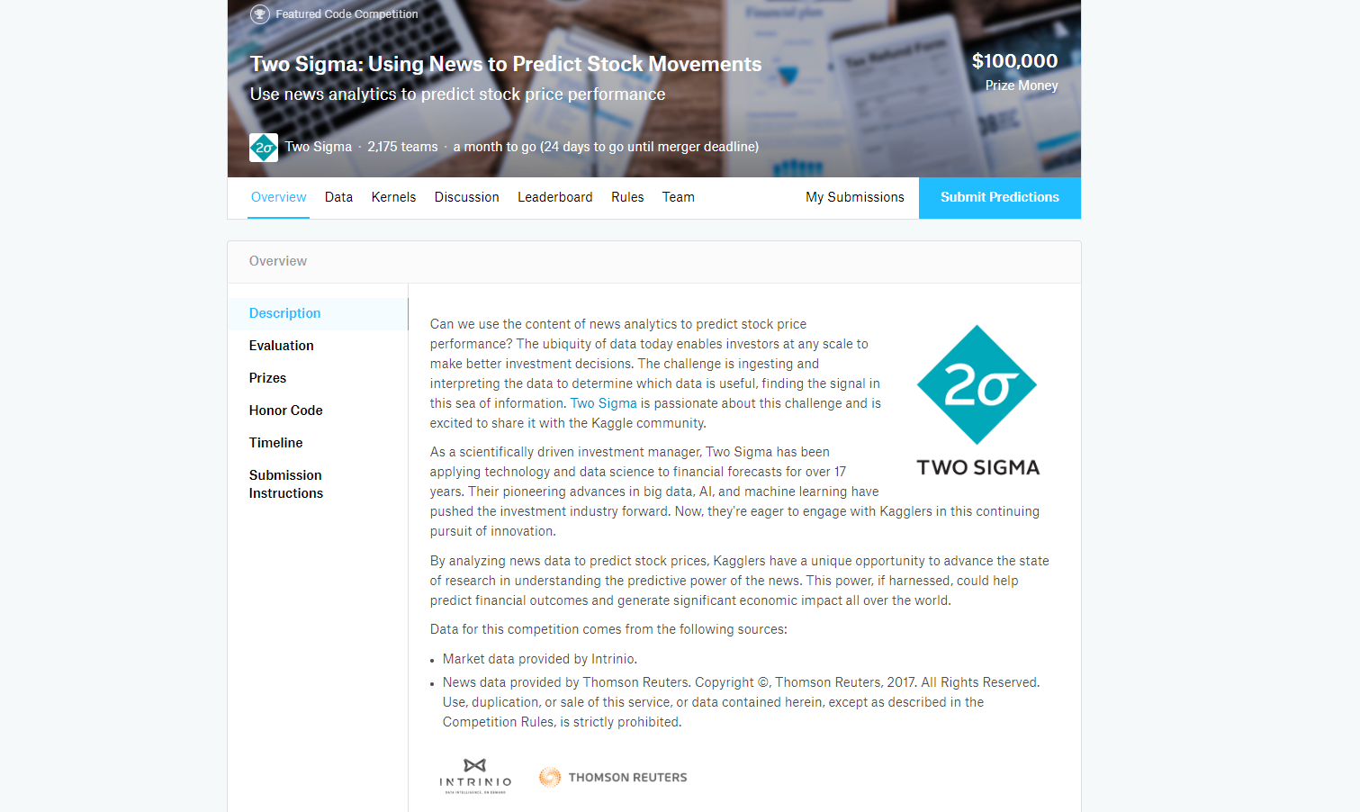
https://www.kaggle.com/c/two-sigma-financial-news

Slide 5
The Overview

Slide 6
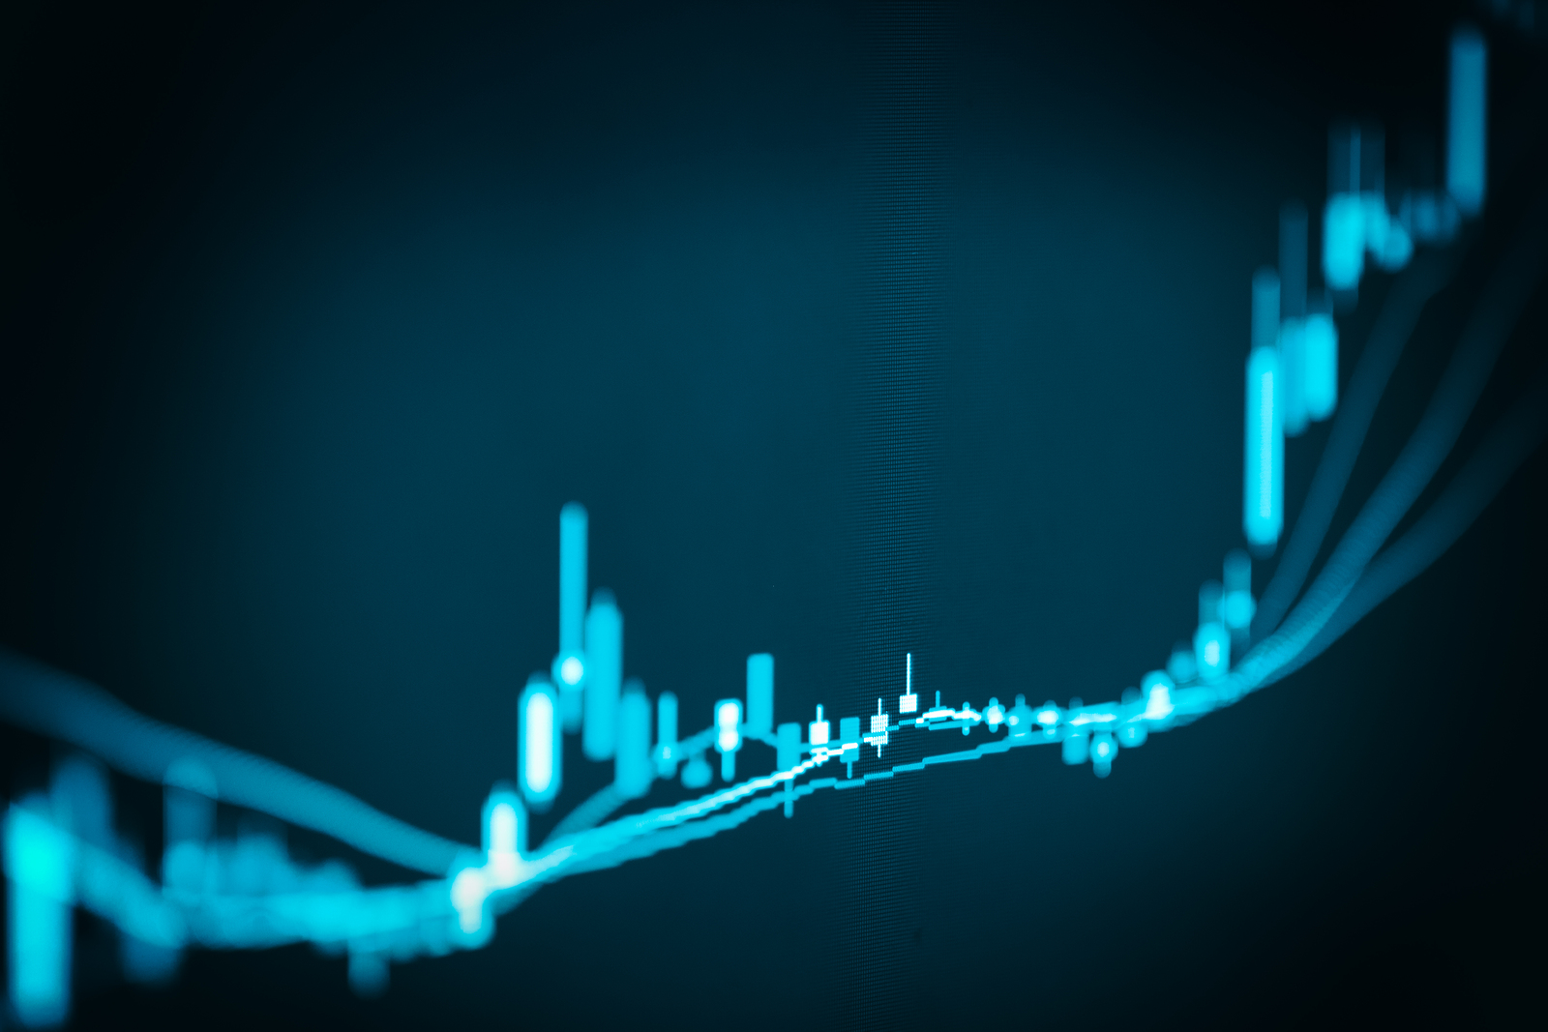
Description
Use news analytics to predict stock price performance.
The data make better investment decisions.
The challenge:
Ingesting and interpreting useful data
finding the signal in this sea of information.

Slide 7



Data
Market data provided by Intrinio.
News data provided by Thomson Reuters.

Slide 8
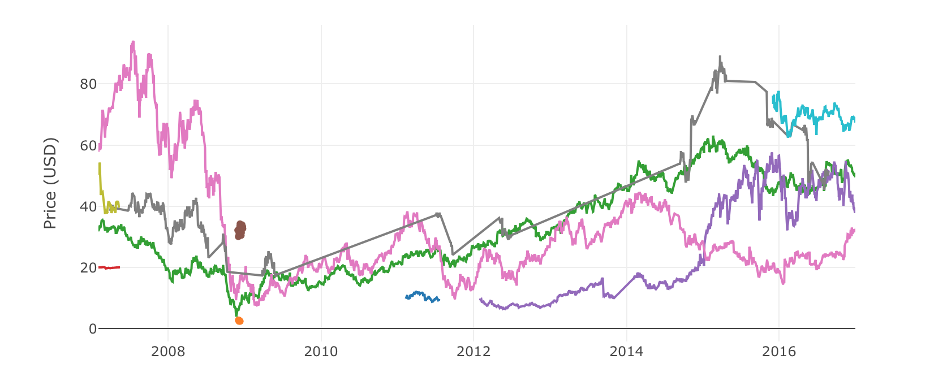
Closing Prices of 10 Random Assets
Notes:
By using the data sets, I plot data for all periods because I'd like to show long-term trends. Assets are sampled randomly, but you should see that some companies' stocks started trading later, some disappeared. Disappearance could be due to bankruptcy, acquisition or other reasons.

Slide 9
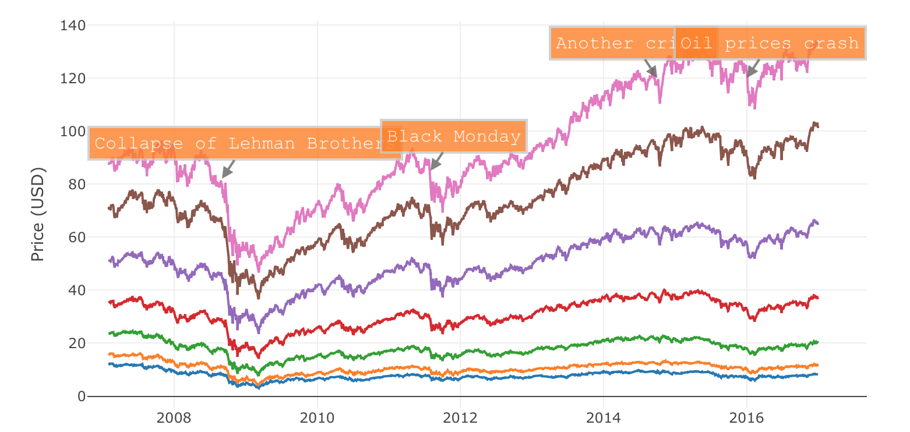
Trends of Closing Prices by Quantiles
Notes:
It is cool to be able to see how markets fall and rise again. I have shown 4 events when there were serious stock price drops on the market. You could also notice that higher quantile prices have increased with time and lower quantile prices decreased.

Slide 10
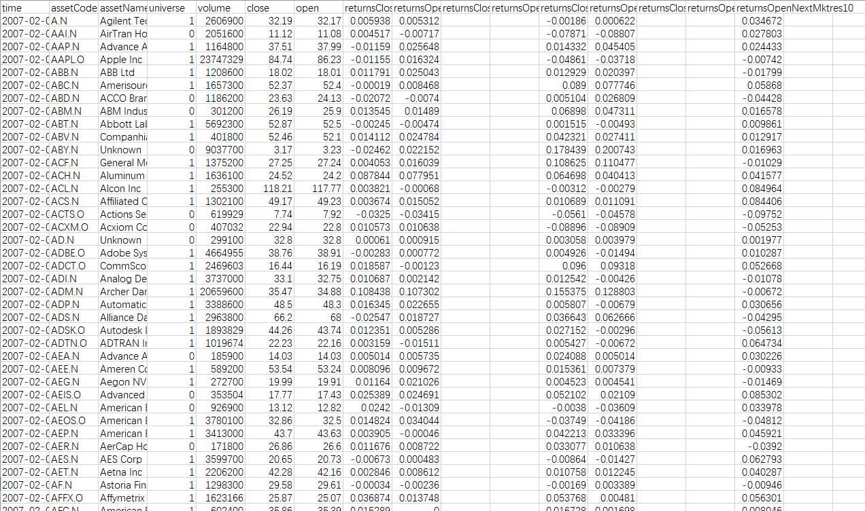
Market Price Sample Data

Slide 11
News Sample Data

Slide 12
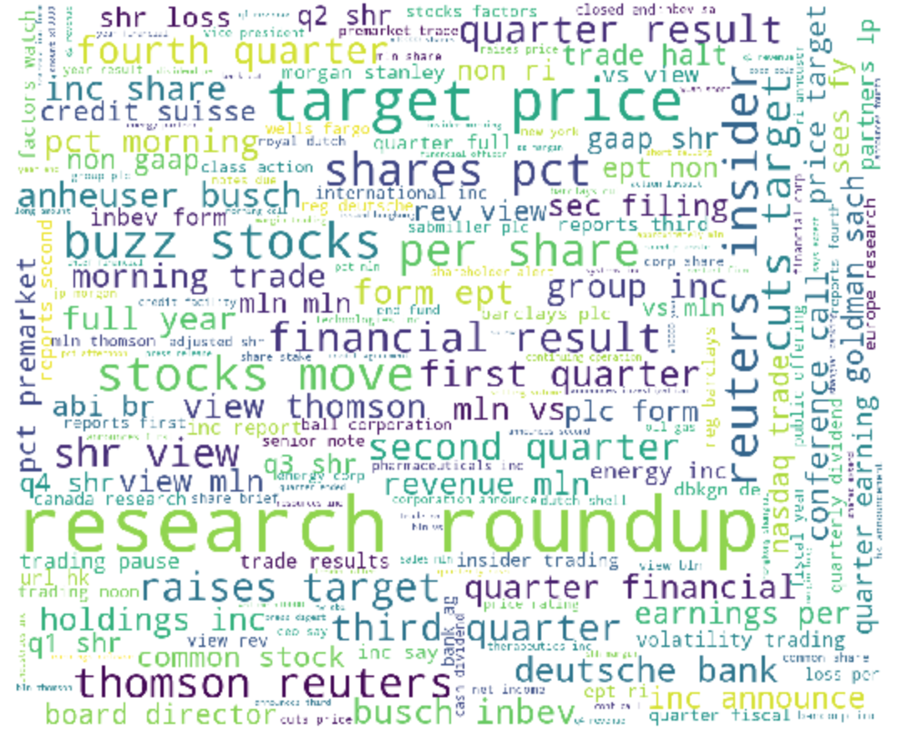
Top Words in Headline

Slide 13
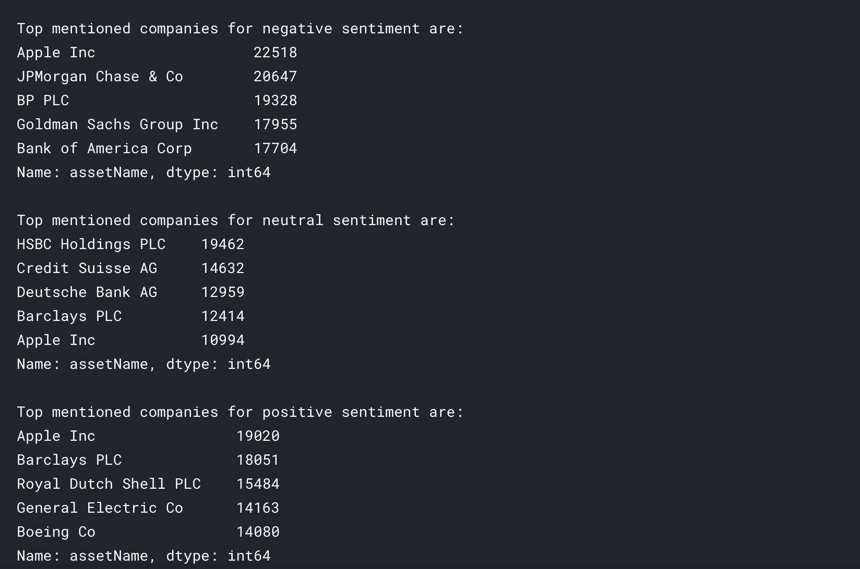
Top mentioned companies for sentiment
Notes:
I think it is quite funny that Apple is a company with most both negative and positive sentiments. At first I was sad that we don't have access to the texts of the news, but I have realized that we won't be able to use them anyway due to kernel memory limitations.

Slide 14
Methodology
Data Processing
Machine Learning Boosting Algorithm

Slide 15
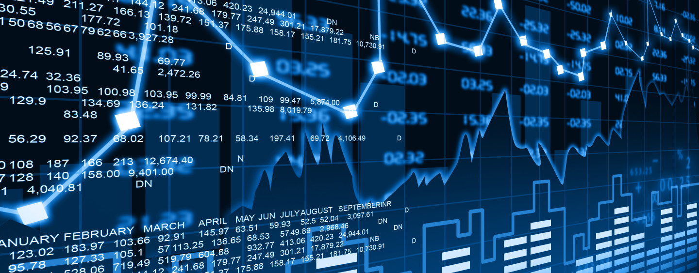
Data Processing

Slide 16
Data Processing
The effect of news on the stock price will last for a period of time
Assuming the this effect decreases overtime
For every piece of news in time point 1, multiply its features by a decay weight, and add to time point 2
Consider the effect of one piece of news in the following days

Slide 17
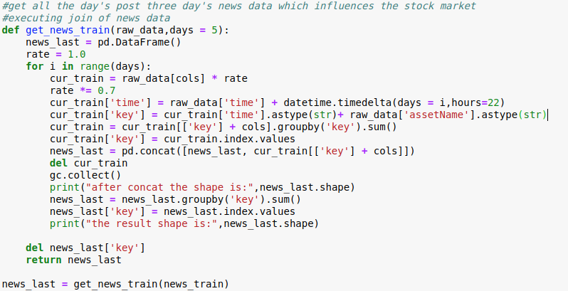
Add time-weighted effect of each news
Notes:
I think it is quite funny that Apple is a company with most both negative and positive sentiments. At first I was sad that we don't have access to the texts of the news, but I have realized that we won't be able to use them anyway due to kernel memory limitations.

Slide 18
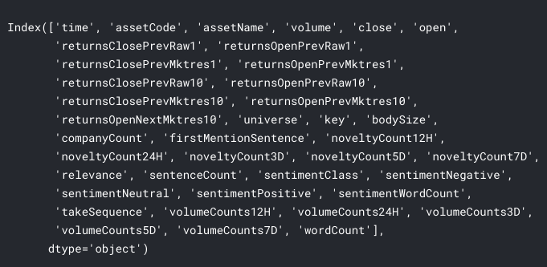
Data Processing
Merge two datasets by time and asset Name.
Merge news data and market data

Slide 19
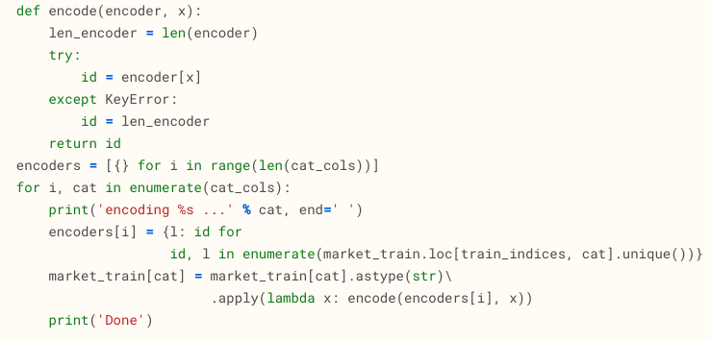
Data Processing
Use a numeric numeric index to represent categorical feature
Encoding categorical data

Slide 20

Machine, Learning
Light GBM
Notes:
Light GBM is a gradient boosting framework that uses tree based learning algorithm.

Slide 21
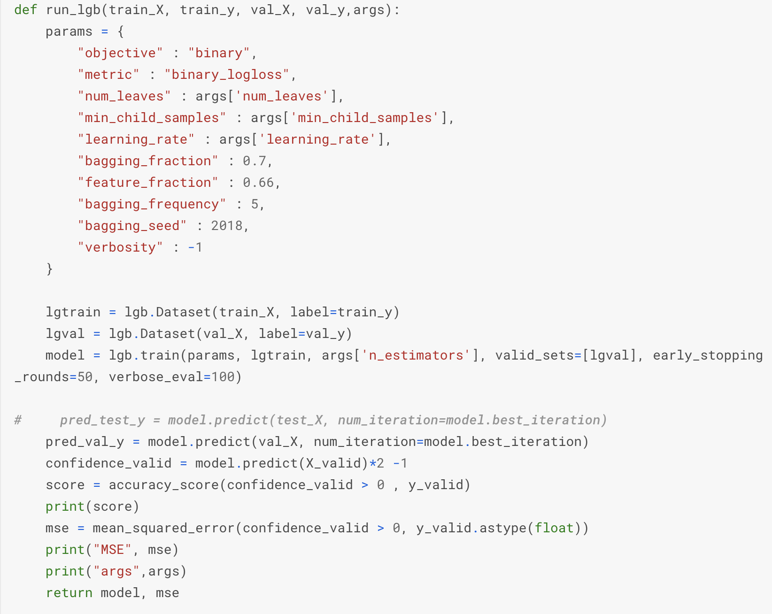
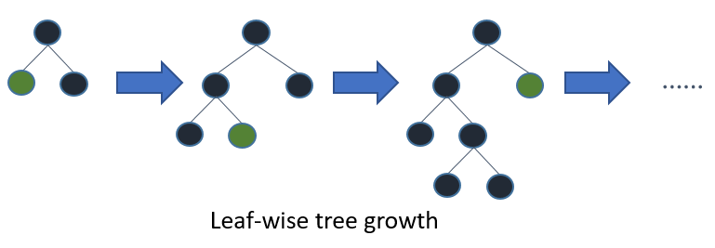
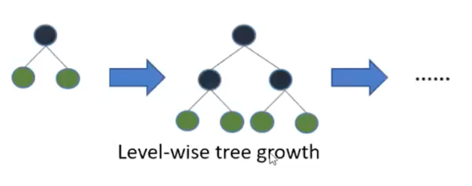
Notes:
Light GBM grows tree vertically which is leaf-wise while other algorithm grows trees horizontally. It will choose the leaf with max delta loss to grow. When growing the same leaf, Leaf-wise algorithm can reduce more loss than a level-wise algorithm.
Why we are using Light GBM?
Light GBM is prefixed as ‘Light’ because of its high speed. Light GBM can handle the large size of data and takes lower memory to run. Another reason of why we use lightGBM is because it focuses on accuracy of results. It produces much more complex trees by following leaf wise split approach rather than a level-wise approach which is the main factor in achieving higher accuracy

Slide 22
What didn’t work?

Slide 23

XGBOOST LightGBM
 | XGBoost
parameter used | max_depth: 50 learning_rate: 0.01 min_child_weight: 1 n_estimators: 200
training AUC | 0.87
training Time | 21642s
 | LightGBM
parameter used | max_depth: 50 learning_rate: 0.01 num_leaves: 30 n_estimators: 200
training AUC | 0.89
training Time | 16755s

Slide 24
Feature Extraction

Slide 25
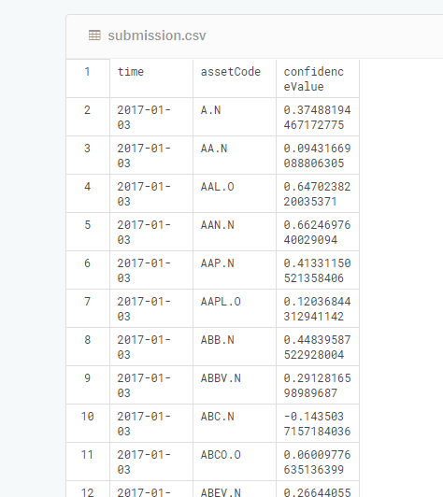
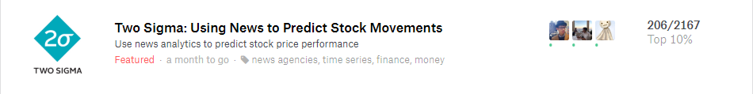
Result

Slide 26
In-Progress Work
Expand source of news(for better model rather than just this Kaggle competition)
More feature engineering work on the news data
May separate different models for market data and news data

Slide 27
Contribution Division
Sibo Zhu: Developing LightGBM, Feature engineering, Researching related works, Extracting useful ideas from the wisdom of internet, Code Processing and Team management.​
Yuchen Zhang: Helping with developing LightGBM and designing Feature Engineering, contributing to the final presentation and final report, researching on related works.
Daniel Zhang: Developed descriptive analysis and worked on parameter tuning for different models.
Wenxiao Xiao: Preprocessing data, merge market and news datasets, designing Feature Engineering

Slide 28
Reference
https://www.kaggle.com/dster/two-sigma-news-official-getting-started-kernel
https://www.kaggle.com/artgor/eda-feature-engineering-and-everything
https://www.kaggle.com/smasar/tutorial-timeseriesapproach
https://www.kaggle.com/mjbahmani/linear-algebra-for-data-scientists
https://www.kaggle.com/bguberfain/a-simple-model-using-the-market-and-news-data
https://www.kaggle.com/christofhenkel/market-data-nn-baseline

Slide 29





